Slide 1

Level7 Education
Case Study Pack for Paper 1 (M24)
Before One PLC (BON)
Notes:
This PowerPoint Pack accompanies the main Case Study Pack for the Before One PLC (BON) case study.

Slide 2

Paper 1 – Case Study Pack (M24)
The new format of the Paper 1 Case Study Pack (CSP) now contains the following:
Glossary of key terms from the pre-release statement.
Additional glossary of key terms relevant to the case study and the music festivals industry.
Two different case studies (for reference and exam practice only).
Two separate Paper 1 mock exams using the new assessment format.
Full mark schemes for both mock exams.
Comprehensive PowerPoint presentation that includes lesson activities, assessment advice, embedded videos (to provide additional context to the case study), exam-practice questions, and accompanying teachers’ notes.
Over 1,200 IB World Schools have used our Paper 1 CSP in the past, and the feedback has been extremely positive.
For additional resources for the IB DP Business Management course, visit our website: https://www.level7education.net

Slide 3
The new Paper 1 – an overview
Paper 1 overview
Based on pre-released statement of around 200 words that provides the context and background for the unseen case study.
Common paper for both SL and HL, with no HL content
Qualitative focus
Calculator permitted (there may be simple calculations in the exam)
No formulae sheet
Recommended 5 hours of research time
1 hour and 30 minutes exam (plus 5 minutes reading time)
35% weighting for SL, and 25% for HL
Notes:
Explanations of the above points can be found in the official guide available on My IB

Slide 4
The new Paper 1 – an overview (cont’d)
Paper 1 overview
Command words indicate the level of skill that is being assessed in each question.
Learning the command terms will help students to comprehend the demands of each question.
It will also improve the quality of their written answers and time management.
Assessment objectives: AO1 - Demonstration of knowledge and understanding AO2 - Demonstration of application and analysis AO3 - Demonstration of synthesis and evaluation AO4 - Demonstration of a variety of appropriate skills, specific to the subject.
Notes:
Explanations of the above points can be found in the official guide available on My IB

Slide 5
Command terms (first exams M24)
Define (AO1)
Describe (AO1)
Identify (AO1)
List (AO1)
Outline (AO1)
State (AO1)
Analyse (AO2)
Apply (AO2)
Comment (AO2)
Demonstrate (AO2)
Distinguish (AO2)
Explain (AO2)
Suggest (AO2)
Compare (AO3)
Compare and contrast (AO3)
Contrast (AO3)
Discuss (AO3)
Evaluate (AO3)
Examine (AO3)
Justify (AO3)
Recommend (AO3)
To what extent (AO3)
Annotate (AO4)
Calculate (AO4)
Complete (AO4)
Construct (AO4)
Determine (AO4)
Draw (AO4)
Label (AO4)
Plot (AO4)
Prepare (AO4)
Notes:
Please refer to pages 67 – 68 in the guide for a definition of each of the above command terms.

Slide 6
Paper 1 (cont’d)
  Section A
  Answer all structured questions based on the case study.
  The maximum score = 20 marks.
  All 5 units of the syllabus can be assessed, excluding the HL only topics.
  Section B
  Answer one out of two extended response questions.
  The maximum score = 10 marks.
  All 5 units of the syllabus can be assessed, excluding the HL only topics.
  Duration = 1 hour 30 mins.
  The total number of marks for Paper 1 (SL and HL) = 30 marks.
  The overall weighting of Paper 1 for SL is 35% and 25% for HL.

Slide 7
Pre-release statement – Before One PLC (BON)
Music festivals are growing in number globally. Festivals vary in location, size, and music genre. They include commercial multiple-day events on farmland and community-led events in public-owned parks.
Before One PLC (BON), a European company, has organized music festivals since 2001. In 2016, BON converted from a private limited company to a public limited company to raise finance for expansion. BON has 60 permanent employees but also relies on temporary workers and freelancers.
BON organizes five music festivals each year and has contracts with five farmers to use their farmland for an average fee of $100 000. BON must clean up after a festival at an average cost of $250 000 per festival. BON’s directors regard environmental sustainability as a significant challenge.
BON’s festival season runs from May to August. Each music festival runs from Friday to Sunday. Each festival site:
takes two weeks to set up and one week to dismantle.
requires security fencing, 60 stages, enough space for camping, 3000 toilets, and 25 000 waste bins.
Try to find at least 10 key terms from the case study (there are at least 14)
Notes:
Understanding the terminology and context beforehand (given in the pre-release statement) helps students to absorb new information during the actual Paper 1 exam.
Try to find at least 10 key terms from the case study (there are at least 14)

Slide 8
Pre-release statement – Before One PLC (BON)
Music festivals are growing in number globally. Festivals vary in location, size, and music genre. They include commercial multiple-day events on farmland and community-led events in public-owned parks.
Before One PLC (BON), a European company, has organized music festivals since 2001. In 2016, BON converted from a private limited company to a public limited company to raise finance for expansion. BON has 60 permanent employees but also relies on temporary workers and freelancers.
BON organizes five music festivals each year and has contracts with five farmers to use their farmland for an average fee of $100 000. BON must clean up after a festival at an average cost of $250 000 per festival. BON’s directors regard environmental sustainability as a significant challenge.
BON’s festival season runs from May to August. Each music festival runs from Friday to Sunday. Each festival site:
takes two weeks to set up and one week to dismantle.
requires security fencing, 60 stages, enough space for camping, 3000 toilets, and 25 000 waste bins.
Notes:
Students should now write definitions for each of these key terms. Approach this in the same way as in the external exams, with each definition worth 2 marks.

Slide 9

Student activities…
  Identify and define all the key terms from the pre-release statement.
  Key terms can be explicitly tested in the Paper 1 exam
  Highlight all possible key terms.
  Define all of these in the context of the business.
  Award up to 2 marks for each definition.
Notes:
Students should now write definitions for each of these key terms (shown in bold on the previous slide). Approach this in the same way as in the external exams, with each definition worth 2 marks.

Slide 10
Definitions – getting these right
Break-even
BTL promotion
Capital expenditure
Communication
Ethical objectives
Job production
Leadership
Management
Sales revenue
Salaries
Sources of finance
Triple bottom line
Location
Company
Privately held company
Publicly held company
Finance
Expansion
Employees
Fee
Average cost
Directors
Challenge(s)
Environmental sustainability
Notes:
The terms above (not in italics) are defined in the section “Key Terms” in the main Case Study Pack.
The terms in italics are not featured in the pre-release case study but may link well with the pre-release statement. See the section titled “Additional Key Terms” in the Case Study Pack for definitions and application to the pre-release and Before One PLC.

Slide 11

Student activities… context and content
  Create an A3 poster for one of the following:
  Impact of COVID-19 on music festivals
  Credit cards as a source of finance
  Freelancers in the music industry
  Greenwashing and business ethics
  The impact of interest rates on businesses
  Landfill sites and environmental sustainability
  Solar power and environmental sustainability
  Operations management and music festivals
Notes:
A couple of examples are shared on the next slide

Slide 12
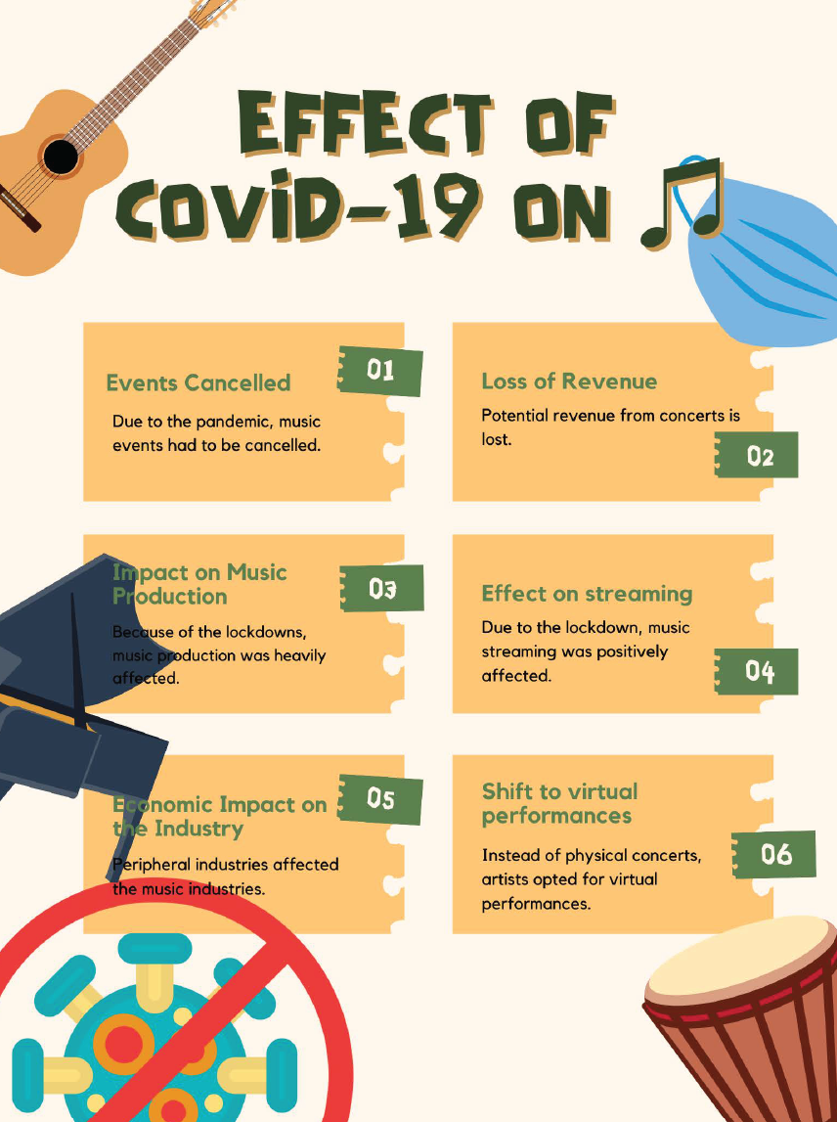

Student activities… context and content
(example posters)
Notes:
These examples of the contextual posters were created by students at KiiT International School, Bhubaneswar, India

Slide 13

Additional student activities…
  Read the pre-release statement – twice!
  Use the margins to make note of relevant:
  Business management tools and theories
  Decisions that need to be made
  Individuals / key stakeholder groups
  Constraints / Challenges / Threats / Limitations
  Issues / Conflicts / Problems
  Business opportunities.
Notes:
This activity helps students to consider the wider aspects of the business and case study not provided in the pre-release statement.

Slide 14
Additional student activities…
  Watch the following six documentary videos:
  Music festivals – a high-risk business from FT Film.
  Why are music festivals so expensive? from The Economist
  How to be an entrepreneur – Music, Mud and Making Money from the BBC Teach.
  What is a franchise? – Music, Mud and Making Money from the BBC Teach.
  Different types of companies: LTD vs PLC – Music, Mud and Making Money from the BBC Teach.
  Understanding profit and loss – Music, Mud and Making Money from the BBC Teach.
Notes:
Music festivals: a high-risk business from FT Film https://youtu.be/_9womMYx3yw
Why are music festivals so expensive? from The Economist
How to be an entrepreneur – Music, Mud and Making Money from the BBC Teach https://youtu.be/8zlFzxmxXfE
What is a franchise? – Music, Mud and Making Money from the BBC Teach https://youtu.be/sfXMfm6XiOM
Private limited companies vs. public limited companies from BBC Teach https://youtu.be/OFIuIiml1q0
Understanding profit and loss - Music, Mud and Making Money from the BBC Teach https://youtu.be/wCds6YxPUv8

Slide 15

Video documentary – Music festivals (FT Film)
Notes:
Music festivals: a high-risk business | FT Film https://youtu.be/_9womMYx3yw
Watch this 20-minute documentary film about the business of running music festival – perfect for the BON case study!
The video features the Glastonbury Festival, which has similar features with BON, e.g., it has around 60 stages and plenty of farmland space for campers attending the musical festival.

Slide 16

Video documentary – Music festivals (FT Film)
Notes:
Watch this 8-minute video about the extremely high costs of running music festivals and why it is challenging for organisers to reach break-even, despite sell-out events.
Business management terminology covered in this video include costs, revenues, profits, economies of scale, challenges (risks), and market research.

Slide 17

Video documentary – Entrepreneurs & business opportunities
Notes:
Watch this short video about entrepreneurship in the context of the music festivals industry.
The video covers numerous parts of the syllabus, including content coverage of entrepreneurship, business opportunities, gaps in the market, intellectual property rights, legal business entities, and market research.
YouTube link: https://youtu.be/8zlFzxmxXfE

Slide 18

Video documentary – Franchising
Notes:
This is a great video to revise franchising, in the context of the musical festivals industry.
https://youtu.be/sfXMfm6XiOM

Slide 19

Video documentary – LTD. vs PLC
Notes:
This is a great video to revise the differences between private and public limited companies, in the context of the musical festivals industry.
https://youtu.be/OFIuIiml1q0

Slide 20

Video documentary – Costs, revenues, and profits
Notes:
This is a great video to revise cash flow management, costs, revenues, break-even, and profits, in the context of the musical festivals industry.
https://youtu.be/wCds6YxPUv8

Slide 21
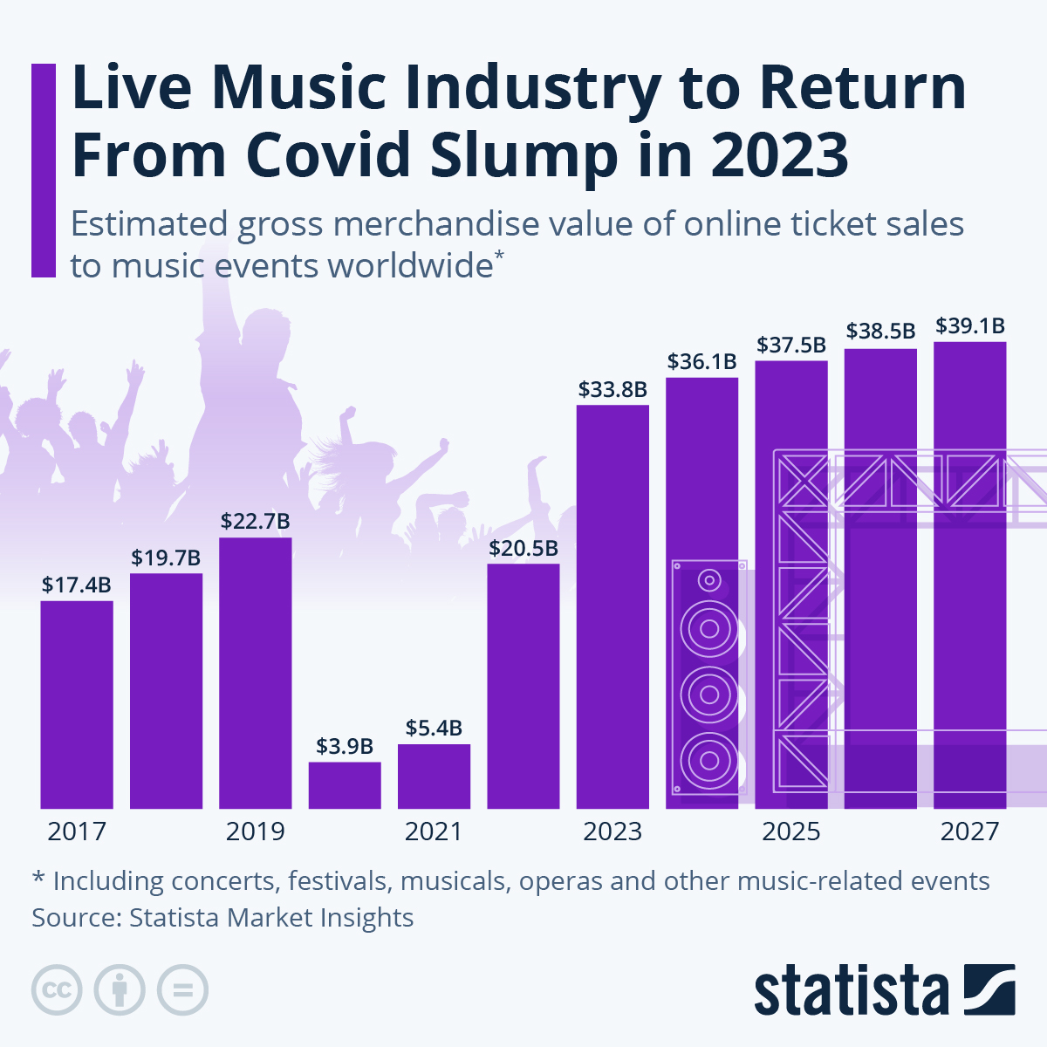
Student activities… context for the Paper 1 exam
  Inquiry-based tasks
  The key factors that influence the success of music festival.
  Music festival trends.
  The costs of running musical festivals.
  The world’s largest music festivals.
  How music festivals have changed over time.
  The future of music festivals.
Notes:
According to estimates from Statista Market Insights, the entire music event industry, including music festivals and concerts, is expected to return to its pre-pandemic growth trajectory as shown above.
Source: https://www.statista.com/chart/30261/estimated-gross-merchandise-value-of-online-ticket-sales-to-music-events-worldwide/

Slide 22
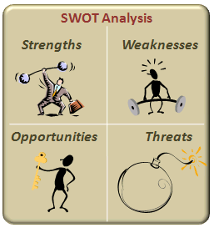
Student activities…
Prepare a SWOT analysis for BON, outlining the opportunities and threats.
Produce this on the large sheets of poster paper.
Discuss how the analysis can be used by the directors of BON to formulate strategy / decision making to maintain profitability in running music festivals.
Notes:
Students are encouraged to conduct secondary (desk) research to find data to back their analyses. For example, Statista findings (previous slide) shows that organizers of music festivals, such as Glastonbury Festival, can look forward to the long-awaited return-to-normal gigs, whereby music lovers can enjoy the most carefree summer since 2019 (after which COVID-19 hit).

Slide 23

Student activities…
BMT – STEEPLE analysis.
Prepare a STEEPLE analysis for BON.
Use real-world data, as appropriate, to support your analysis.
This can be useful for the 10-mark extended response question in Section B.
Notes:
See notes for previous slide (SWOT analysis)

Slide 24
Exam practice questions (Section A)
1. | Define the term expansion (line 6). | [2 marks]
2. | Define the term environmental sustainability (line 10). | [2 marks]
3. | Describe two elements of BON’s marketing mix for its running music festivals. | [4 marks]
4. | Explain one advantage and one disadvantage for BON of operating as a seasonal business (line 12). | [4 marks]
5. | Outline the importance of location for BON (line 1). | [2 marks]
6. | Explain one advantage and one disadvantage for BON of relying on temporary workers and freelancers (lines 6 – 7). | [6 marks]
Notes:
Note that some of these questions appear in the mock exam papers in the main Case Study Pack

Slide 25
Tackling the exam questions …
  For the 2-mark questions in Section A, students may be asked to:
  Define ...
  State two ...
  Describe one ...
  Outline one ...
Notes:
These 2-mark questions use AO1 command terms

Slide 26
Tackling the exam questions …
  Examples of 2-mark questions in Section A:
  Define the term private limited company (line 5). [2 marks]
  State two features of a publicly held company (line 5). [2 marks]
  Describe one suitable source of finance for BON to fund its music festivals. [2 marks]
  Outline one reason why BON might want to expand its operations (line 6). [2 marks]
Notes:
These 2-mark questions use AO1 command terms

Slide 27
Tackling the exam questions …
  For the 4-mark and 6-mark questions in Section A, students may be asked to:
  Explain ...
  Distinguish between ...
  Suggest ...
  Comment on...
  Analyze …
Notes:
These 2-mark questions use AO2 command terms

Slide 28
Tackling the exam questions …
  For the 4-mark and 6-mark questions in Section A, students may be asked to:
  Explain two reasons for BON converting from a private limited company to a public limited company (line 5). [4]
  Distinguish between corporate social responsibility (CSR) and sustainability. [4]
  Suggest one reason why BON may have faced liquidity issues during the COVID-19 pandemic. [4]
  Comment on why BON’s directors regard environmental sustainability as a significant challenge (lines 9 – 10). [4]
  Analyze the role of effective operations management for BON. [6]
Notes:
These 2-mark questions use AO2 command terms

Slide 29
Tackling the exam questions …
  For the 6-mark questions in Section A, students must demonstrate:
  An analysis of the relevant issues with good use of business management tools and theories.
  Use of appropriate terminology throughout the response.
  Make effective use of the stimulus material (application).
Notes:
Application is crucial for all 6-mark questions. Without appropriate application of the stimulus material, candidates will typically be awarded no more than half of the available marks.

Slide 30
Tackling the exam questions (Section B)
  For the 10-mark question in Section B, students must demonstrate:
  Clear focus on addressing the demands of the question.
  Relevant and accurate use of business management tools and theories.
  Relevant information from the stimulus material is integrated effectively to support the argument.
  Arguments are substantiated and balanced.
  Explanation of the limitations of the case study or stimulus material.
Notes:
Remind students that they should answer only one question in Section B

Slide 31

Tackling the exam questions … “AT ABC”
  Scoring top marks for the 10-mark question in Section B:
  Answer the question in its entirety.
  Tools, theories, techniques, terminology used effectively.
  Application of the stimulus materials.
  Balanced (two-sided) arguments.
  Conclusion – substantiated with evidence and logical reasoning.

Slide 32
Tackling the exam questions … Section B
  Each of the two questions will feature an AO3 command term.
  Some questions will ask students to evaluate a decision:
    Provide at least two arguments for the option and two arguments against.
  Others will ask students to choose between two options:
    Provide at least one argument for and one argument against each option.
  Use appropriate business management terminology.
  Apply the response to the stimulus (case study) material.
  Provide a conclusion that addresses potential future action or additional implications.
Notes:
Source: Teacher Support Material, page 56

Slide 33
Exam practice questions (Section B)…
With reference to BON, discuss the importance of corporate social responsibility (CSR). [10 marks]
To what extent should environmental sustainability be a key strategic priority for the directors of BON (lines 10 – 11)? [10 marks]
Examine the impact of the external environment on the operations of BON. [10 marks]
Evaluate the impact of changes in the external environment on BON’s profitability. [10 marks]
Recommend whether BON should change its pricing or add a sixth music festival to raise the company’s profits. [10 marks]
Notes:
Remind students that they should answer only one question in Section B

Slide 34
Tackling the 10-mark Paper 1 exam question …
  Relevant and accurate use of business management tools and theories.
Refer to the tools and theories as stated and/or implied in the question.
Demonstrate knowledge and understanding of the tools and theories.
Include appropriate business management terminology.
Use definitions and applied examples as and where appropriate.
Notes:
Clear focus on addressing the demands of the question.
Relevant and accurate use of business management tools and theories.
Relevant information from the stimulus material is integrated effectively to support the argument.
Arguments are substantiated and balanced.
Explanation of the limitations of the case study or stimulus material.

Slide 35
Tackling the 10-mark Paper 1 exam question …
  Relevant information from the stimulus material is integrated effectively to support the argument
Apply the relevant business management tools and theories to the case study organization (BON).
Explain the situation and issues or challenges faced by the organization.
Ensure examples used are appropriate and illustrative.
Go beyond just mentioning “BON”.
Notes:
Clear focus on addressing the demands of the question.
Relevant and accurate use of business management tools and theories.
Relevant information from the stimulus material is integrated effectively to support the argument.
Arguments are substantiated and balanced.
Explanation of the limitations of the case study or stimulus material.

Slide 36
Tackling the 10-mark Paper 1 exam question …
  Arguments are substantiated and balanced
Present relevant and balanced arguments.
Depending on the demands of the question:
Present strengths and weaknesses.
Consider opportunities and threats.
Compare and contrast.
Justifying all arguments with evidence – do not allow examiners to question “why?”
Notes:
Clear focus on addressing the demands of the question.
Relevant and accurate use of business management tools and theories.
Relevant information from the stimulus material is integrated effectively to support the argument.
Arguments are substantiated and balanced.
Explanation of the limitations of the case study or stimulus material.

Slide 37
Tackling the 10-mark Paper 1 exam question …
  Arguments are substantiated and balanced (cont’d...)
Give a balanced (two-sided) consideration to the perspectives of a range of relevant stakeholders.
Where appropriate, include individuals (by name) and groups internal and external to the organization.
Notes:
Clear focus on addressing the demands of the question.
Relevant and accurate use of business management tools and theories.
Relevant information from the stimulus material is integrated effectively to support the argument.
Arguments are substantiated and balanced.
Explanation of the limitations of the case study or stimulus material.

Slide 38
Tackling the 10-mark Paper 1 exam question …
  Explanation of the limitations of the case study or stimulus material
What does the data not show?
Consider correlation vs causation.
Consider implications on the organization’s:
  Finances.
  Human resources.
Think in an original and critical way.
Notes:
Clear focus on addressing the demands of the question.
Relevant and accurate use of business management tools and theories.
Relevant information from the stimulus material is integrated effectively to support the argument.
Arguments are substantiated and balanced.
Explanation of the limitations of the case study or stimulus material.

Slide 39

Evaluation framework (1) – DEAD & DEADER
Definitions
Examples
Advantages
Disadvantages
Evaluation
Recommendation(s)
Notes:
This writing framework can be used for the AO3 questions worth 10 marks in Paper 1. Within the extended response, students should demonstrate the following, as appropriate to the demands of the question:
Definitions of any key terms
Examples to help clarify understanding and knowledge
Advantages
Disadvantages (the advantages and disadvantages help to provide a two-sided, balanced argument)
Evaluation (critical thinking skills)
Recommendation(s), where appropriate to the question.

Slide 40


Evaluation framework (2) – DATE & PALS
The DATE rule
Definition(s)
Application
Tools and theories
Evaluation
The PALS rule
Priorities
Assumptions
Long term vs. short term
Stakeholders
Notes:
This alternative writing framework can be used for the AO3 questions worth 10 marks in Paper 1. Within the extended response, students should demonstrate the following, as appropriate to the demands of the question:
Definitions of any key terms that are worth defining
Application of the stimulus material, both from the pre-release statement and the case study material seen on the day of the exam
Tools and theories that help to explain, analyse, or discuss the arguments, written in the context of the case study
Evaluation (critical thinking skills) – see SLAP below.
Priorities of the organization – align these with its mission or vision statement if provided in the case study
Assumptions – what information is missing (i.e., not provided in the case study) that would help to make a more informed decision or recommendation?
Long term vs short term – consider both the implications in the immediate time, near future, and distant future
Stakeholders – which stakeholder groups win or lose from the decision or recommendation being made? And why/how?

Slide 41
Final top tips!
Avoid copying large chunks of the case study, even if these are in quotation marks.
Avoid memorizing answers to predicted questions, as this can hinder your ability to address the actual exam questions effectively.
Information and quantitative data presented in the case study must be used to support your arguments.
Application is crucial in Paper 1. For the 10-mark question, a purely theoretical response will typically earn 4 marks or fewer.
Show original thought in your conclusion and evaluation – do not repeat a list of advantages and disadvantages.
For the 10-mark question, answer the question in its entirety.
Refer to the mark allocations for each question when writing the answers.

Slide 42
Review Questions …
Can quantitative questions appear in the Paper 1 exam?
Are students provided with a formulae sheet in the Paper 1 exam?
Do students need a calculator for this exam?
Are there any AO3 questions in Part A of the Paper 1 exam?
What is examined in Section B?
What are the total number of marks for Paper 1?
What is the weighting of the Paper 1 exam for SL? HL?
How long does the IB recommend that schools should spend on the pre-release statement?
Notes:
35% weighting for SL
25% weighting for HL

Slide 43
Review Questions … and answers
Can quantitative questions appear in the Paper 1 exam? Yes
Are students provided with a formulae sheet in the Paper 1 exam? No
Do students need a calculator for this exam? Not required but permitted
Are there any AO3 questions in Part A of the Paper 1 exam? No
What is examined in Section B? An AO3 extended response question
What are the total number of marks for Paper 1? 30 marks
What is the weighting of the Paper 1 exam for SL? 35% HL? 25%
How long does the IB recommend that schools should spend on the pre-release statement? 5 hours
Notes:
35% weighting for SL
25% weighting for HL

Slide 44

All the best for the Paper 1 examination!

