Slide 1
Criteria B past paper qs

Slide 2
November 2019

Slide 3
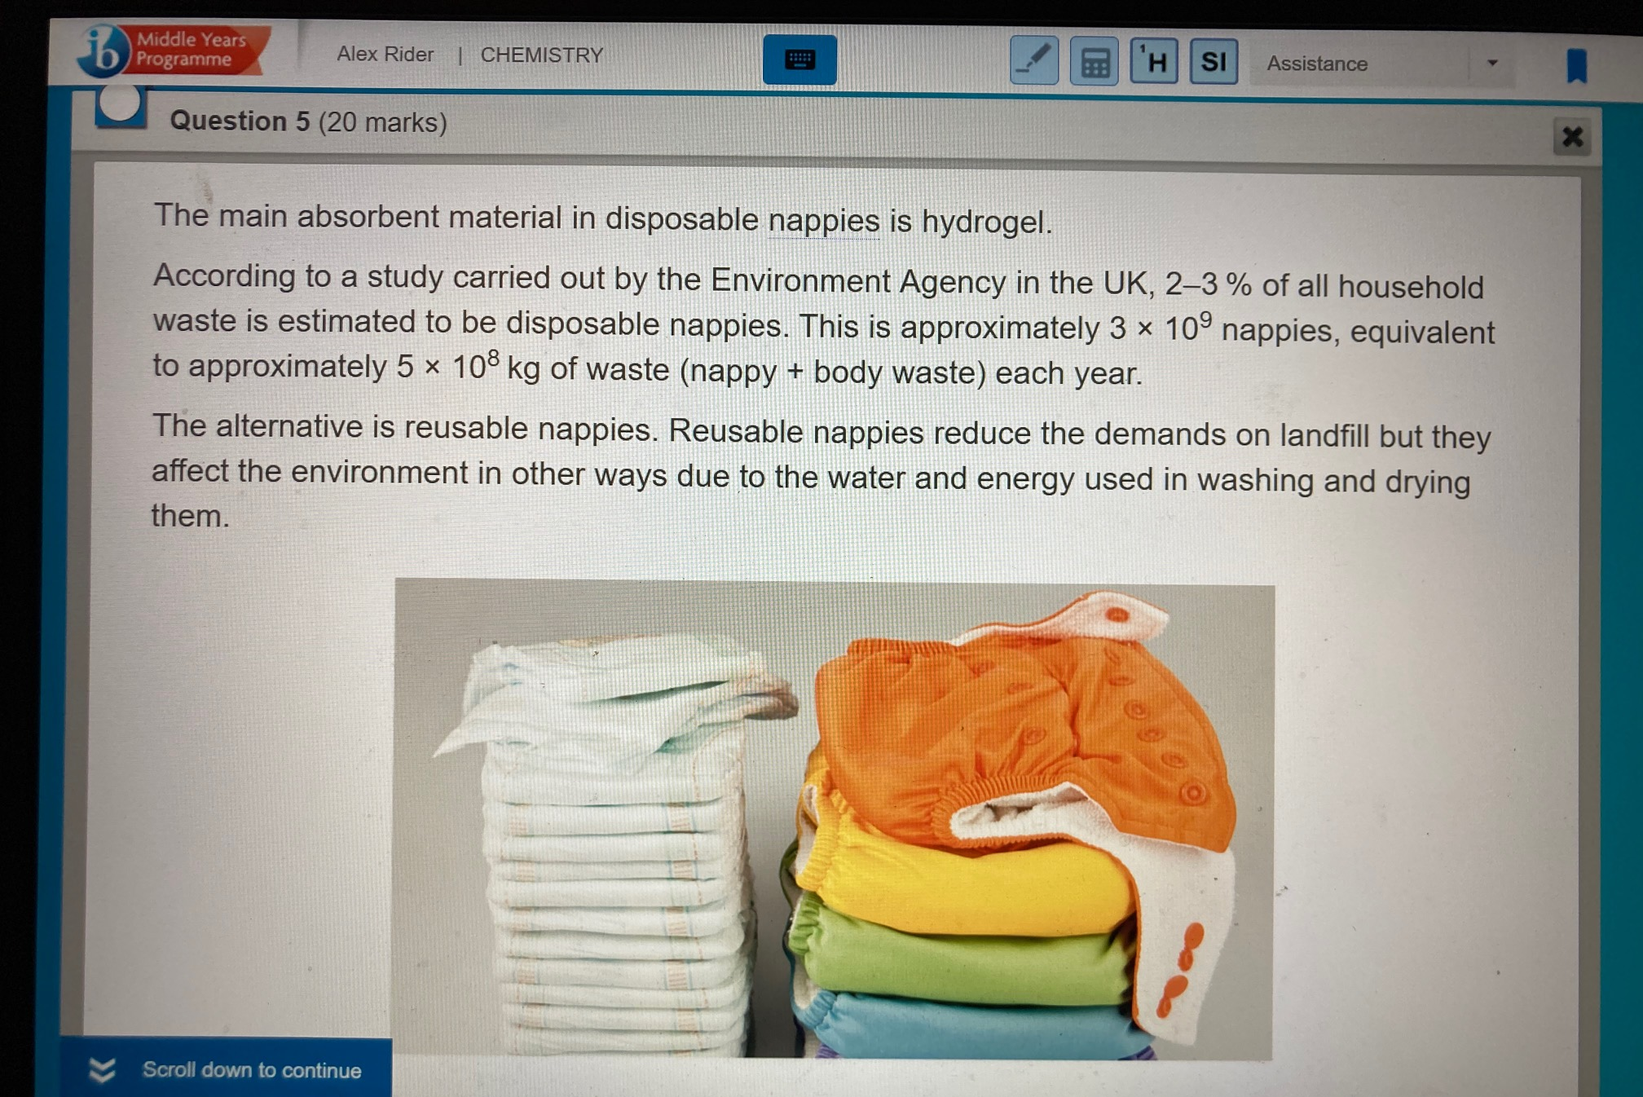

Slide 4
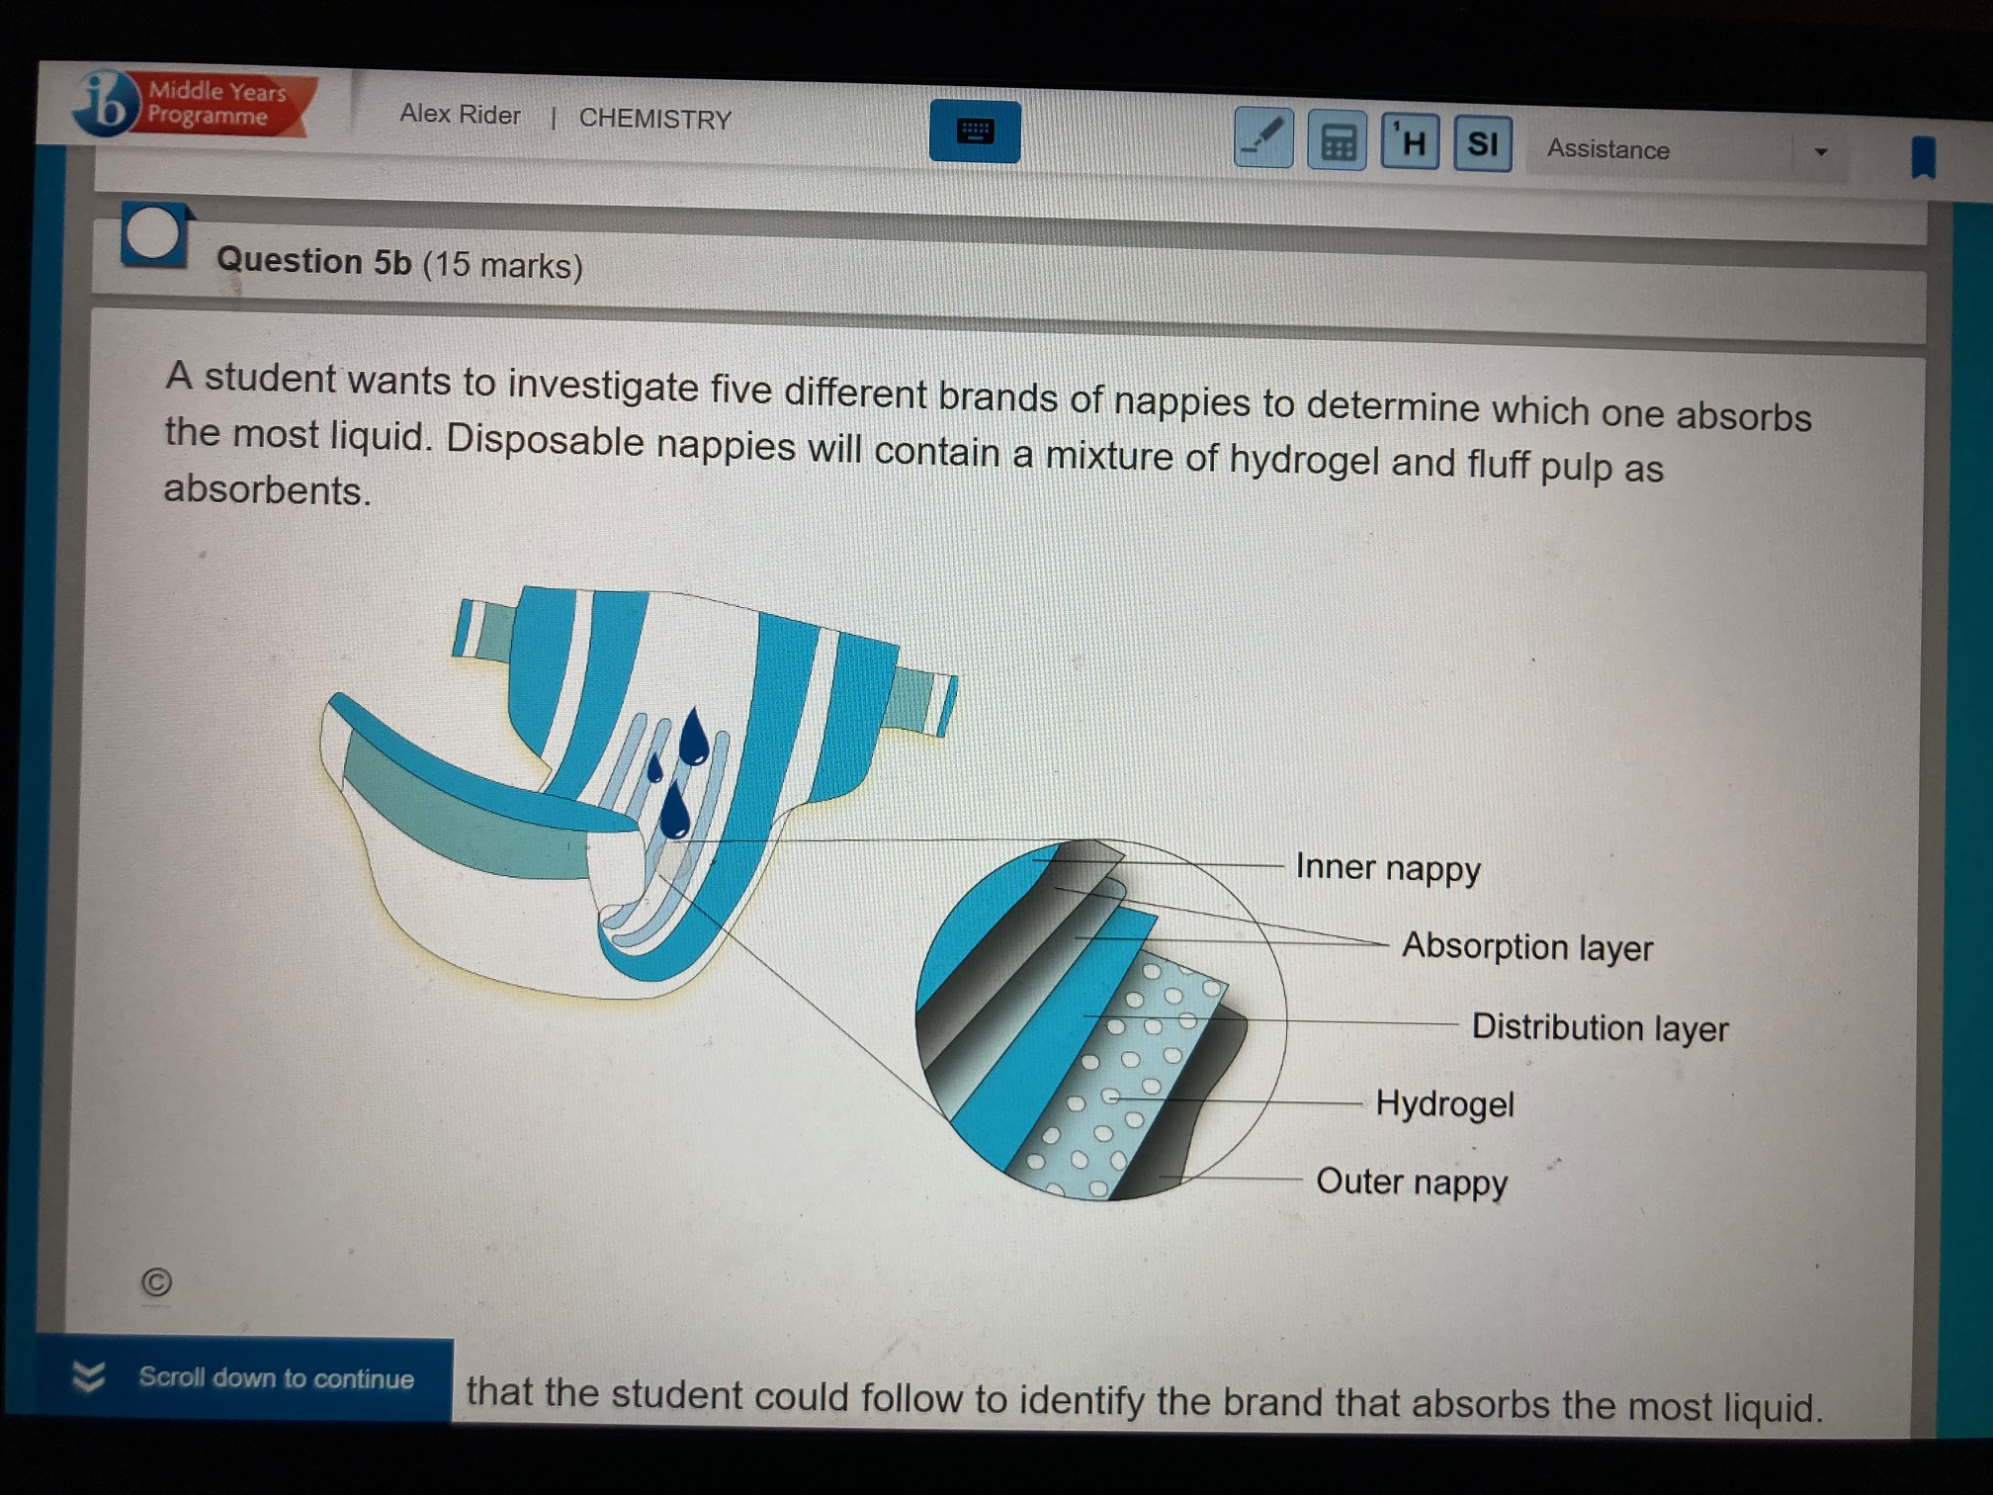

Slide 5
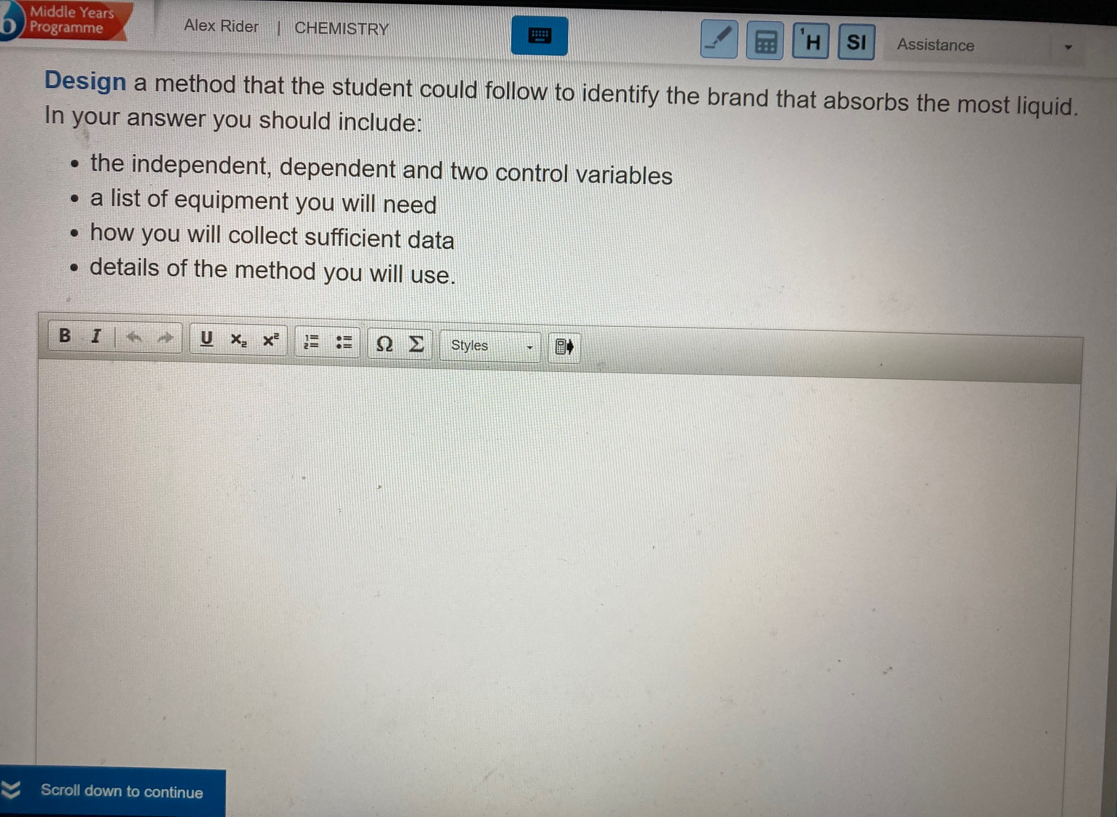

Slide 6
May 2019

Slide 7
